Slide 1
Chapter 5
Robbins and Judge
Personality and Values
Notes:
Chapter 5 introduces us the the concepts of personality and values and their effects on Organizational Behavior. These are concepts that have only recently received increased attention in research and practice. Here we will see the results of study and new applications to help make the work place more successful.

Slide 2
personality
Personality is a dynamic concept describing the growth and development of a person’s whole psychological system
It looks at some aggregate whole that is greater than the sum of the parts.
Defining Personality
Personality as the sum total of ways in which an individual reacts to and interacts with others.
Managers can use personality tests in hiring decisions and help forecast who is best for a job.
The common means of measuring personality is
through self-report surveys.
Observer-ratings surveys provide an independent assessment of personality.
Notes:
We begin by defining personality. This is a concept that has a lot of preconceived ideas in people. So we want to ensure we are all using the same basic definition to describe a very complex topic. Personality is a dynamic concept, meaning it is changing all the time, an that is is the total of growth and development of a psychological system for the individual. This suggests it includes all of the components of the psyche and their aggregate becomes greater than any of the parts. So the text definition is that personality if the sum total of ways in which an individual reacts to and interacts with others.

Slide 3
Determinants of personality
Heredity refers to those factors that were determined at conception.
The heredity approach argues that the ultimate explanation of an individual’s personality is the molecular structure of the genes, located in the chromosomes.
Popular characteristics include shy, aggressive, submissive, lazy, ambitious, loyal, and timid. These are personality traits.
Early efforts to identify the primary traits that govern behavior often resulted in long lists that were difficult to generalize from and provided little practical guidance to organizational decision makers.
Notes:
An early argument centered on whether or not personality was the result of heredity or of environment. Personality appears to be a result of both influences. Heredity refers to those factors that were determined at conception. The heredity approach argues that the ultimate explanation of an individual’s personality is the molecular structure of the genes, located in the chromosomes. Researchers have studied thousands of sets of identical twins that were separated at birth.
Popular characteristics include shy, aggressive, submissive, lazy, ambitious, loyal, and timid. These are personality traits. Early efforts to identify the primary traits that govern behavior often resulted in long lists that were difficult to generalize from and provided little practical guidance to organizational decision makers.

Slide 4
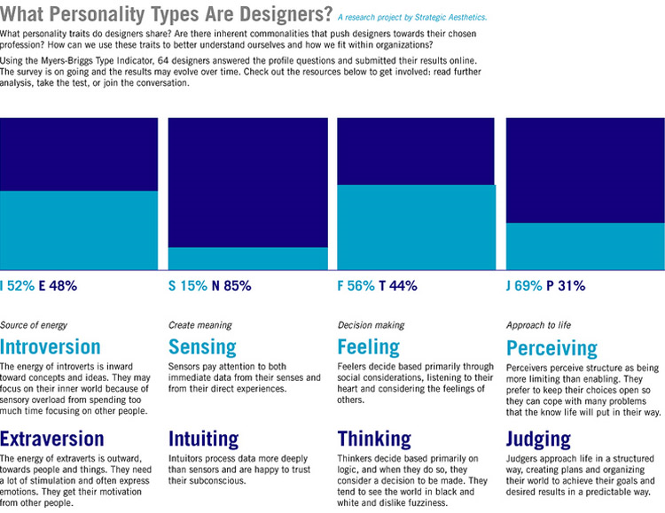
Describe the Myers-Briggs Type Indicator personality framework and assess its strengths and weaknesses
LO 2
One of the most widely used personality frameworks is the Myers-Briggs Type Indicator (MBTI).
Individuals are classified as:
Extroverted or introverted (E or I).
Sensing or intuitive (S or N).
Thinking or feeling (T or F).
Perceiving or judging (P or J).
Notes:
One of the most widely used personality frameworks is the Myers-Briggs Type Indicator (MBTI). Individuals are classified as Extroverted or introverted (E or I), Sensing or intuitive (S or N), Thinking or feeling (T or F) Perceiving or judging (P or J). These classifications are then combined into sixteen personality types.

Slide 5
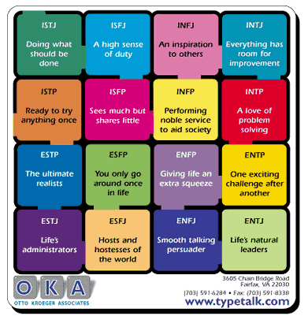
the Myers-Briggs Type Indicator personality framework
INTJs are visionaries.
ESTJs are organizers.
ENTPs are conceptualizers.
Notes:
For example:
INTJs are visionaries. They usually have original minds and great drive for their own ideas and purposes. They are characterized as skeptical, critical, independent, determined, and often stubborn.
ESTJs are organizers. They are realistic, logical, analytical, decisive, and have a natural head for business or mechanics.
The ENTP type is a conceptualizer. He or she is innovative, individualistic, versatile, and attracted to entrepreneurial ideas. This person tends to be resourceful in solving challenging problems but may neglect routine assignments.
MBTI is widely used in practice. Some organizations using it include Apple Computer, AT&T, Citigroup, GE, 3M Co. and others.

Slide 6
The Big Five personality model
Emotional Stability
It refers to a person’s ability to withstand stress. Calm, self-confident, secure under stress (positive), versus nervous, depressed, and insecure under stress (negative)
Extroversion
It refers to comfort level with relationship. Sociable, gregarious, and assertive
Openness to Experience
It refers to one’s range of interest. Curious, imaginative, artistic, and sensitive
It refers to an individual’s propensity to differ to others. Good-natured, cooperative, and trusting
It refers to the number of goals on which a person focuses. Responsible, dependable, persistent, and organized
Agreeableness
Conscientiousness
Notes:
An impressive body of research supports that five basic dimensions underlie all other personality dimensions. The five basic dimensions are Extraversion, Agreeableness, Conscientiousness, Emotional stability, Openness to experience. Let’s look at each of these for a minute.
Extraversion is a comfort level with relationships. Extroverts tend to be gregarious, assertive, and sociable. Introverts tend to be reserved, timid, and quiet. Agreeableness is Individual’s propensity to defer to others. High agreeableness people are cooperative, warm, and trusting. Low agreeableness people are cold, disagreeable, and antagonistic. Conscientiousness is a measure of reliability. A high conscientious person is responsible, organized, dependable, and persistent. Those who score low on this dimension are easily distracted, disorganized, and unreliable. Emotional stability describes a person’s ability to withstand stress. People with positive emotional stability tend to be calm, self-confident, and secure. Those with high negative scores tend to be nervous, anxious, depressed, and insecure. And lastly, Openness to experience suggests the range of interests and fascination with novelty. Extremely open people are creative, curious, and artistically sensitive. Those at the other end of the openness category are conventional and find comfort in the familiar.

Slide 7
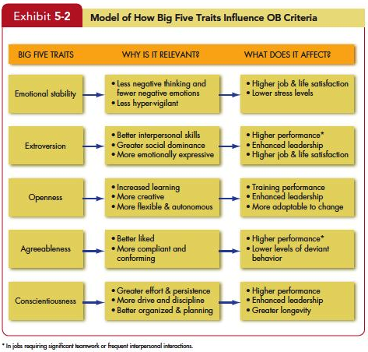
the Big Five traits predict behavior at work
Notes:
All five traits also have other implications for work and for life. Let’s look at these one at a time. Exhibit 5-2 summarizes the points.
Of the Big Five traits, emotional stability is most strongly related to life satisfaction, job satisfaction, and low stress levels. This is probably true because high scorers are more likely to be positive and optimistic and experience fewer negative emotions. They are happier than those who score low. People low on emotional stability are hypervigilant (looking for problems or impending signs of danger) and are especially vulnerable to the physical and psychological effects of stress.
Extraverts tend to be happier in their jobs and in their lives as a whole. They experience more positive emotions than do introverts, and they more freely express these feelings. They also tend to perform better in jobs that require significant interpersonal interaction, perhaps because they have more social skills—they usually have more friends and spend more time in social situations than introverts. Finally, extraversion is a relatively strong predictor of leadership emergence in groups; extraverts are more socially dominant, “take charge” sorts of people, and they are generally more assertive than introverts. One downside is that extraverts are more impulsive than introverts; they are more likely to be absent from work and engage in risky behavior such as unprotected sex, drinking, and other impulsive or sensation-seeking acts. One study also found extraverts were more likely than introverts to lie during job interviews.
Individuals who score high on openness to experience are more creative in science and art than those who score low. Because creativity is important to leadership, open people are more likely to be effective leaders, and more comfortable with ambiguity and change. They cope better with organizational change and are more adaptable in changing contexts. Recent evidence also suggests, however, that they are especially susceptible to workplace accidents. You might expect agreeable people to be happier than disagreeable people. They are, but only slightly. When people choose romantic partners, friends, or organizational team members, agreeable individuals are usually their first choice. Agreeable individuals are better liked than disagreeable people, which explains why they tend to do better in interpersonally oriented jobs such as customer service. They also are more compliant and rule abiding and less likely to get into accidents as a result.
People who are agreeable are more satisfied in their jobs and contribute to organizational performance by engaging in citizenship behavior. They are also less likely to engage in organizational deviance. One downside is that agreeableness is associated with lower levels of career success (especially earnings).

Slide 8
the Big Five traits at work
The five factors appear in almost all cross-cultural studies.
Differences are complex but seem to depend on whether countries are predominantly individualistic or collectivistic.
They appear to predict a bit better in individualistic than in collectivist cultures.
Notes:
The five personality factors identified in the Big Five model appear in almost all cross-cultural studies. These studies have included a wide variety of diverse cultures—such as China, Israel, Germany, Japan, Spain, Nigeria, Norway, Pakistan, and the United States. Differences are complex but tend to be primarily about whether countries are predominantly individualistic or collectivistic. And the Big Five appear to predict a bit better in individualistic rather than in collectivist cultures.

Slide 9
other personality traits relevant to OB
Core Self-Evaluation (Self-perspective)
Machiavellianism (Machs)
Narcissism
Self-Monitoring
Risk Taking
Type A personality
Proactive Personality
Notes:
Some other Personality Traits Relevant to OB include Core Self-Evaluation, Machiavellianism, Narcissism, Self-Monitoring, Risk Taking, Proactive Personality, and Other orientation. Let’s look at each of these.
People who have a positive core self-evaluation see themselves as effective, capable, and in control. People who have a negative core self-evaluation tend to dislike themselves. Some can be too positive. In this case, someone can think he or she is capable, but he or she is actually incompetent?
An individual high in Machiavellianism is pragmatic, maintains emotional distance, and believes that ends can justify means. High Machs manipulate more, win more, are persuaded less, and persuade others more. High Mach outcomes are moderated by situational factors and flourish when they interact face-to-face with others, rather than indirectly, and when the situation has a minimum number of rules and regulations, thus allowing latitude for improvisation. High Machs make good employees in jobs that require bargaining skills or that offer substantial rewards for winning.
Narcissism describes a person who has a grandiose sense of self-importance. They “think” they are better leaders. Often they are selfish and exploitive.
Self-Monitoring refers to an individual’s ability to adjust his or her behavior to external, situational factors. Individuals high in self-monitoring show considerable adaptability. They are highly sensitive to external cues, can behave differently in different situations, and are capable of presenting striking contradictions between their public persona and their private self.
The propensity to assume or avoid risk has been shown to have an impact on how long it takes managers to make a decision and how much information they require before making their choice. High risk-taking managers make more rapid decisions and use less information in making their choices. Managers in large organizations tend to be risk averse; especially in contrast with growth-oriented entrepreneurs.
Proactive Personality is a person who actively takes the initiative to improve hiss or her current circumstances while others sit by passively Proactives identify opportunities, show initiative, take action, and persevere.
Some people just naturally just seem to think about other people a lot, being concerned about their well-being and feelings while others behave like “economic actors,” primarily rational and self-interested. Those who are other-oriented feel more obligated to help others who have helped them (pay me back), whereas those who are more self-oriented will help others when they expect to be helped in the future (pay me forward). Employees high in other-orientation also exert especially high levels of effort when engaged in helping work or prosocial behavior.

Slide 10
Personality Traits Relevant to OB
Core Self-Evaluation
The degree to which people like or dislike themselves
People with positive core self evaluation like themselves, and see themselves as effective, capable and in control of their environment.
Positive self-evaluation leads to higher job performance. They set more ambitious goal, more committed to their goals. Get promoted more rapidly.
Machiavellianism
A pragmatic, emotionally distant power-player who believes that ends justify the means
High Machs are manipulative, win more often, and persuade more than they are persuaded. Flourish when:
Have direct interaction
Work with minimal rules and regulations
Emotions distract others
Notes:
There are additional personality traits relevant to organizational behavior. Core self-evaluation is the degree to which people like/dislike themselves. Positive self-evaluation leads to higher job performance. Machiavellianism describes a person who tends to be emotionally distant and believes that the ends justify the means. They tend to have a competitive drive and a need to win. They can be very persuasive in situations where there is direct interaction with minimal rules and people are distracted by emotions.

Slide 11
More Relevant Personality Traits
Narcissism
An arrogant, entitled, self-important person who needs excessive admiration
Tend to be selfish, exploitative and treat others as if they were inferior.
Less effective in their jobs
Self-Monitoring
The ability to adjust behavior to meet external, situational factors.
Striking contradiction between public persona and private self.
Pay more attention to others behavior.
High monitors conform more and are more likely to become leaders.
Less committed to the organization, get more rapid promotion.

Slide 12
More Relevant Personality Traits
Risk Taking
The willingness to take chances.
May be best to align propensities with job requirements.
Risk takers make faster decisions with less information.
Proactive Personality
Identifies opportunities, shows initiative, takes action, and perseveres to completion
Creates positive change in the environment

Slide 13
More Relevant Personality Traits
Type A Personality
Aggressively involved in a chronic, incessant struggle to achieve more in less time
Impatient: always moving, walking, and eating rapidly
Strive to think or do two or more things at once
Cannot cope with leisure time
Obsessed with achievement numbers
Prized in North America but quality of the work is low
Type B people are the complete opposite
Notes:
Type A personalities are defined as those who need to achieve more and more. They are always moving, striving to multitask and don’t do well with leisure time. This is something that has been valued in North America, but it is not always a positive as quality of work can be low. Type B personalities operate at a slower pace, find time for leisure and are the opposite of all type A characteristics.
Proactive personalities are those that identify opportunities, take initiative, and persevere to completion in all they do. This is a positive in work environments.

Slide 14
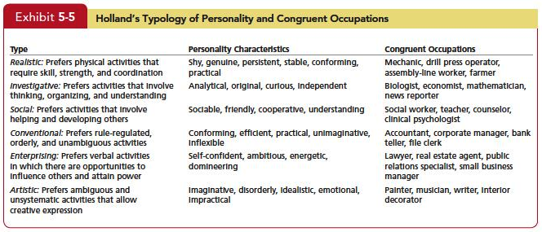
Linking an Individual’s Personality and Values to the Workplace
Notes:
The concept of Person-Job Fit is best articulated in John Holland’s personality-job fit theory. Holland presents six personality types and proposes that satisfaction and the propensity to leave a job depends on the degree to which individuals successfully match their personalities to an occupational environment. He identifies six personality types. They are realistic, investigative, social, conventional, enterprising, and artistic .

Slide 15
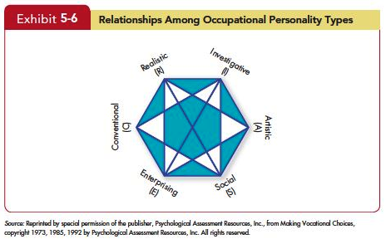
Linking an Individual’s Personality and Values to the Workplace
Notes:
Each one of the six personality types has a congruent occupational environment. The Vocational Preference Inventory questionnaire contains 160 occupational titles. Respondents indicate which of these occupations they like or dislike. Their answers are used to form personality profiles. The theory argues that satisfaction is highest and turnover lowest when personality and occupation are in agreement. The key points of this model are that there do appear to be intrinsic differences in personality among individuals, there are different types of jobs, and people in jobs congruent with their personality should be more satisfied and less likely to voluntarily resign than people in incongruent jobs.

Slide 16
Linking an Individual’s Personality and Values to the Workplace
People high on extraversion fit well with aggressive and team-oriented cultures,
People high on agreeableness match up better with a supportive organizational climate than one focused on aggressiveness,
People high on openness to experience fit better in organizations that emphasize innovation rather than standardization.
Notes:
The Person-Organization Fit is most important for an organization facing a dynamic and changing environment. Such organizations require employees who are able to readily change tasks and move fluidly between teams It argues that people leave jobs that are not with their personalities. Using the Big Five terminology, for instance, we could expect that people high on extraversion fit well with aggressive and team-oriented cultures, that people high on agreeableness match up better with a supportive organizational climate than one focused on aggressiveness, and that people high on openness to experience fit better in organizations that emphasize innovation rather than standardization. Research on person–organization fit has also looked at whether people’s values match the organization’s culture. This match predicts job satisfaction, commitment to the organization, and low turnover.

Slide 17
Summary and Implications for Managers
Big Five provides a meaningful way for managers to examine personality
Managers’ keys
Screening job candidates for high conscientiousness
Factors such as job demands, the degree of required interaction with others, and the organization’s culture are examples of situational variables that moderate the personality–job performance relationship.
Notes:
Under the category of Personality, we looked at the Big Five Traits. The Big Five provides a meaningful way for managers to examine personality Managers’ key for the application of the Big Five include Screening job candidates for high conscientiousness, as well as the other Big Five traits depending on the criteria an organization finds most important, should pay dividends. Of course, managers still need to take situational factors into consideration. Factors such as job demands, the degree of required interaction with others, and the organization’s culture are examples of situational variables that moderate the personality–job performance relationship.

Slide 18
Summary and Implications for Managers
You need to evaluate the job, the work group, and the organization to determine the optimal personality fit.
Other traits, such as core self-evaluation or narcissism, may be relevant in certain situations, too.
Although the MBTI has been widely criticized, it may have a place in organizations.
Notes:
You need to evaluate the job, the work group, and the organization to determine the optimal personality fit. Other traits, such as core self-evaluation or narcissism, may be relevant in certain situations, too. Although the MBTI has been widely criticized, it may have a place in organizations. In training and development, it can help employees better understand themselves, help team members better understand each other, and open up communication in work groups and possibly reduce conflicts.

