Slide 1
Organizational Behavior 15th Ed
Chapter 3
Robbins and Judge
Attitudes and Job Satisfaction
Notes:
Chapter 3 is a focus on Attitudes and Job Satisfaction. Managers should be interested in their employees’ attitudes because attitudes give warnings of potential problems and influence behavior. Creating a satisfied workforce is hardly a guarantee of successful organizational performance, but evidence strongly suggests that whatever managers can do to improve employee attitudes will likely result in heightened organizational effectiveness. Let’s begin with the Learning Objectives of this chapter.

Slide 2
Components of an Attitude
Evaluative statements or judgments concerning objects, people, or events
Three components of an attitude:
Affective
Cognitive
Behavioral
Attitude
The emotional or feeling segment of an attitude
The opinion or belief segment of an attitude
An intention to behave in a certain way toward someone or something
Notes:
Attitudes are evaluative statements or judgments concerning objects, people, or events. Attitudes are made up of three components. The cognitive component is made up of the belief in the way things are. The affective component is the more critical part of the attitude as it is calls upon the emotions or feelings. The behavioral component describes the intention to behave in a certain way toward someone or something. These three components work together to aid in our understanding of the complexity of an attitude.

Slide 3
Relationship Between Attitudes and Behavior
The attitudes people hold determine what they do.
Festinger proposed that cases of attitude following behavior illustrate the effects of cognitive dissonance.
Cognitive Dissonance is incompatibility an individual might perceive between two or more attitudes or between behavior and attitudes.
Research has generally concluded that people seek consistency among their attitudes and between their attitudes and their behavior.
Notes:
Sometimes we observe people who will change what they say so it doesn’t contradict their behavior. When attitudes and behaviors don’t line up, individuals will experience cognitive dissonance. This incongruity is uncomfortable and individuals will seek to reduce the dissonance to find consistency.
People are willing to live with some discomfort but the degree to which this is true depends upon the importance of the elements, how much influences the individual has in the situation, and the rewards available.

Slide 4
Attitudes and Behavior (contd)
Importance of the attitude
Its correspondence to behavior
Its accessibility
The presence of social pressure
Whether or not a person has had direct experience with the behavior
The attitude/behavior relationship is stronger if it refers to something in our direct personal experience
Attitude
Predicts
Mitigating Variables
Behavior
Notes:
Some variables do moderate the relationship between attitude and behavior. These factors include the importance of the attitude to the person, the correspondence of the attitude to the behavior, the accessibility of the attitude, the existence of social pressures on behavior, and the personal and direct experience of the attitude.
These mitigating variables will affect the ability to predict how a certain attitude will predict behavior. The mitigating variables must be considered in the analysis process to alter what might be considered standard response as behavior to a specific attitude.

Slide 5
The Major Job Attitudes
Job Satisfaction
A positive feeling about the job resulting from an evaluation of its characteristics
Job Involvement
Degree of psychological identification with the job where perceived performance is important to self-worth
Psychological Empowerment
Belief in the degree of influence over the job, competence, job meaningfulness, and autonomy
Notes:
OB focuses our attention on a very limited number of job-related attitudes. Most of the research in OB has been concerned with three attitudes: job satisfaction, job involvement, and organizational commitment. The field of Organizational Behavior focuses on how attitudes will influence the workplace. There are several major job attitudes we will look at throughout the book. The first is job satisfaction, which is the positive feeling about the job resulting from an evaluation of its characteristics. The second is job involvement. Job involvement looks at the degree of psychological identification with the job. An additional job attitude is logical empowerment, the belief in the degree of influence their work environment, their competence, the meaningfulness of their job, and their perceived autonomy.

Slide 6
the Major Job Attitudes
Organizational Commitment
Identifying with a particular organization and its goals, while wishing to maintain membership in the organization.
Three dimensions:
Affective – emotional attachment to organization
Continuance – economic value of staying
Normative – moral or ethical obligations
Organizational Commitment
Has some relation to performance, especially for new employees.
Committed employees will be less likely to engage in work withdrawal even if they are dissatisfied, because they have a sense of organizational loyalty.
Notes:
A very important job attitude is organizational commitment or identifying with a particular organization and its goals. There are three dimensions to this job attitude – affective, continuance commitment, and normative.

Slide 7
the Major Job Attitudes
Perceived Organizational Support (POS)
Degree to which employees believe the organization values their contribution and cares about their well-being.
Higher when rewards are fair, employees are involved in decision making, and supervisors are seen as supportive.
High POS is related to higher OCBs and performance.
Employee Engagement
The degree of involvement with, satisfaction with, and enthusiasm for the job.
Engaged employees are passionate about their work and company.
Notes:
Perceived Organizational Support is the degree to which employees believe the organization values their contribution and cares about their well-being. The perception of fairness in the employees mind is a key factor in determining employees’ willingness to work hard for the organization. In addition, employees have a higher POS when they perceive they have some input to decision-making processes. Employees with strong POS perceptions have been found more likely to have higher levels of organizational citizenship behaviors, lower levels of tardiness, and better customer service.

Slide 8
the Major Job Attitudes
Are These Job Attitudes Really Distinct?
No: these attitudes are highly related
Variables may be redundant (measuring the same thing under a different name)
While there is some distinction, there is also a lot of overlap
Overlap may cause confusion
Notes:
There is a high degree of overlap between the different job attitudes. If a worker has higher job satisfaction, they tend to be more engaged and show a stronger commitment to the organization. Researchers are looking into trying to find ways to measure the different attitudes to get at their distinctiveness. This overlap can cause considerable confusion when trying to assess them.

Slide 9
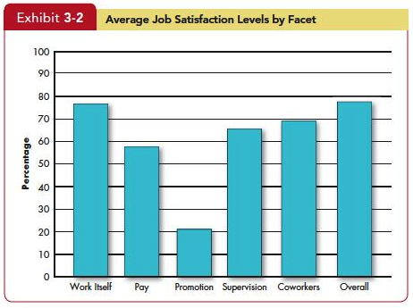
Job Satisfaction
Job satisfaction
A positive feeling about a job resulting from an evaluation of its characteristics
Two approaches for measuring Job Satisfaction are popular:
The single global rating
The summation of job
facets
Notes:
Job satisfaction is defined as a positive feeling about a job resulting from an evaluation of its characteristics. This is an important job attitude because it incorporates so many of the other measures. There are multiple ways to measure job satisfaction, but the most accurate way is to ask the question if people are satisfied in their jobs and provide them with a scale to report their degree of satisfaction. The single global rating is a response to one question, such as “All things considered, how satisfied are you with your job?” Respondents circle a number between 1 and 5 on a scale from “highly satisfied” “highly dissatisfied.” The second method, the summation of job facets, is more sophisticated. It identifies key elements in a job such as the nature of the work, supervision, present pay, promotion opportunities, and relations with coworkers.

Slide 10
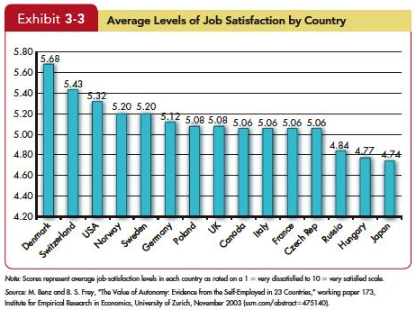
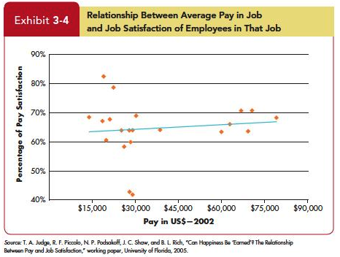
Causes of Job Satisfaction
Pay influences job satisfaction only to a point.
After about $40,000 per year (in the U.S.), there is no relationship between amount of pay and job satisfaction.
Money may bring happiness, but not necessarily job satisfaction.
Notes:
Pay has an influence on job satisfaction but not as much as one might think. Typically, once a worker exceeds $40,000 per year, pay has limited impact on the level of satisfied workers.

Slide 11
Causes of Job Satisfaction
Personality plays a role in Job Satisfaction.
People who have positive core self-evaluations, who believe in their inner worth and basic competence are more satisfied with their jobs than those with negative core self-evaluations.
Those with negative core self-evaluations set less ambitious goals and are more likely to give up when confronting difficulties.
Insert Exhibit 3-22
Notes:
Personality also plays a role in Job Satisfaction. Research has shown that people who have positive core self-evaluations who believe in their inner worth and basic competence—are more satisfied with their jobs than those with negative core self-evaluations. Not only do they see their work as more fulfilling and challenging, they are more likely to gravitate toward challenging jobs in the first place. Those with negative core self-evaluations set less ambitious goals and are more likely to give up when confronting difficulties.

Slide 12
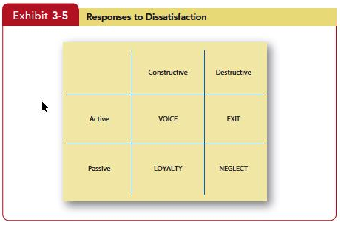
Employee Responses to Dissatisfaction
Insert Exhibit 3-5
Insert Exhibit 3-22
Notes:
There are a number of ways employees can express job dissatisfaction. These include Exit: a Behavior directed toward leaving the organization, including looking for a new position as well as resigning. Additionally Voice is actively and constructively attempting to improve conditions, including suggesting improvements, discussing problems with superiors, and some forms of union activity. Loyalty is passively, but optimistically, waiting for conditions to improve, including speaking up for the organization in the face of external criticism, and trusting the organization and its management to “do the right thing.” Lastly, Neglect involves passively allowing conditions to worsen, including chronic absenteeism or lateness, reduced effort, and increased error rate. Exit and neglect behaviors encompass our performance variables—productivity, absenteeism, and turnover. Voice and loyalty are constructive behaviors allow individuals to tolerate unpleasant situations or to revive satisfactory working conditions. It helps us to understand situations, such as those sometimes found among unionized workers, where low job satisfaction is coupled with low turnover.

Slide 13
Summary and Implications for Managers
Satisfied and committed employees have lower rates of turnover, absenteeism, and withdrawal behaviors.
Managers will also want to measure job attitudes effectively so they can tell how employees are reacting to their work.
The most important thing managers can do to raise employee satisfaction is focus on the intrinsic parts of the job, such as making the work challenging and interesting.
Although paying employees poorly will likely not attract high-quality employees to the organization or keep high performers, managers should realize that high pay alone is unlikely to create a satisfying work environment.
Insert Exhibit 3-22
Notes:
Some take-away ideas from this chapter on Attitudes and Job Satisfaction can be excellent guidelines for management skill development. Understanding these dimensions of Attitudes and Job Satisfaction will permit a manger’s focus on the skills to apply them to the employee/employer relationship. First, satisfied and committed employees have lower rates of turnover, absenteeism, and withdrawal behaviors. They also perform better on the job. Second, given that managers want to keep resignations and absences down—especially among their most productive employees—they’ll want to do things that generate positive job attitudes. Third, managers will also want to measure job attitudes effectively so they can tell how employees are reacting to their work. As one review put it, “A sound measurement of overall job attitude is one of the most useful pieces of information an organization can have about its employees.” The most important thing managers can do to raise employee satisfaction is focus on the intrinsic parts of the job, such as making the work challenging and interesting. Lastly, paying employees poorly will likely not attract high-quality employees to the organization or keep high performers, managers should realize that high pay alone is unlikely to create a satisfying work environment.

