Slide 1
Organizational Behavior 15th Ed
Chapter 1
Robbins and Judge
What Is Organizational Behavior?
Instructor: Dr Nailah Ayub
Notes:
Welcome to this Organizational Behavior course that uses the 15th edition of the textbook, Organizational Behavior by Robbins and Judge. This is considered among the most widely used OB textbooks in the world. Robbins and Judge are recognized as definitive aggregators of OB concepts, applications and practices. The course and this book will provide you with a resource that will benefit you throughout your degree program and your professional life.

Slide 2
Importance of Interpersonal Skills in the Workplace
Interpersonal Skills Result In…
Understanding OB helps determine manager effectiveness
Leadership and communication skills that are critical as a person progresses in a career
Lower turnover of quality employees
Applications for higher quality recruitment
Better financial performance
Notes:
Managers need a whole cadre of skills to create a productive workplace, including technical and quantitative skills. However, leadership and communication skills are critical to organizational success. When managers have solid interpersonal skills, there are positive work outcomes for the organization. These outcomes include lower turnover of strong employees, improved recruitment pools for filling employment positions, and a better bottom line.

Slide 3
Manager’s Functions, Roles And Skills
Manager: Someone who gets things done through other people in organizations.
Planning, organizing, leading, and controlling are the most often studied. (Fayol Management Functions)
Managers work in Organizations
Organization: A consciously coordinated social unit composed of two or more people that functions on a relatively continuous basis to achieve a common goal or set of goals.
Notes:
A Manager is someone in the organization who gets things done through the efforts of other people. It is important to keep in mind that an organization is defined as a social entity comprised of two or more people and can be found at any level within the organization. Henri Fayol of France originally defined the functions of management that became the cornerstone for management study for almost 100 years. These functions are currently defined as planning, organizing, leading and controlling. When thinking about these functions one realization comes forward. They all involve the interpersonal skills of communication for their effective implementation. And. Henry Mintzberg, no you do not have to be named Henry to be a management theorist, looked at management differently when he defined the 10 roles of managers. Again, think on these roles and you will find that they again involve implementation through the interpersonal skills of communication.

Slide 4
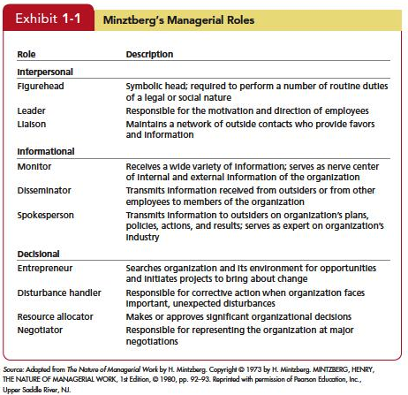
Manager’s Functions, Roles And Skills
Mintzberg: Managers perform ten different, highly interrelated roles or sets of behaviors attributable to their jobs.
Insert Exhibit 1.1
Notes:
In fact, if you look at the three categories of roles suggested by Mintzberg following his research, you’ll note the distribution of communication and interpersonal skills such as tact, diplomacy, and the like, focusing on both internal and external audiences in the role’s activities. For this reason, developing the interpersonal skills introduced in this course are essential to the professional development of young professionals. It is essential to managerial success.

Slide 5
Manager’s Functions, Roles And Skills
Management Skills
Technical Skills--The ability to apply specialized knowledge or expertise. All jobs require some specialized expertise, and many people develop their technical skills on the job.
Human Skills--Ability to work with, understand, and motivate other people, both individually and in groups, describes human skills.
Conceptual Skills--The mental ability to analyze and diagnose complex situations.
Notes:
A study published in the Harvard Business Review in 1960 and in continuing studies throughout the 1980s, three types of skills were attributed to managerial activity. These skills were found to be applied in different ratios depending on the managerial level in the organization. The underlying message here is that young professionals are hired for what they do and veteran professionals are hired for what they think. This is why we have the phenomenon of a CEO from one industry’s company being hired as the CEO of a company in a completely different industry.

Slide 6
Effective Versus Successful Managerial Activities
Luthans and associates found that all managers engage in four managerial activities.
Traditional management: DM, Planning, Controlling
Communication: Exchange routine information and processing paperwork
Human resource management: Motivating, Disciplining, Managing conflict, Staffing and training
Networking: Socializing, Politicking, and interacting with others
Notes:
Luthans and his research associates found the managers engage in four managerial activities. The activities are defined as Traditional management which is decision making, planning, and controlling. The average manager spent 32 percent of his or her time performing this activity. Communication is exchanging in routine information and processing paperwork. The average manager spent 29 percent of his or her time performing this activity. Human resource management includes motivating, disciplining, managing conflict, staffing, and training. The average manager spent 20 percent of his or her time performing this activity. Networking is socializing, politicking, and interacting with outsiders. The average manager spent 19 percent of his or her time performing this activity

Slide 7
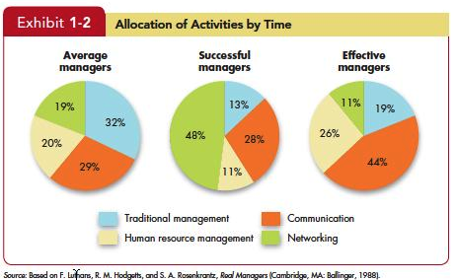
Effective Versus Successful Managerial Activities
Insert Exhibit 1.2
Notes:
Managers who were high performing in these activities were found to be fast- tracked through organizational promotion.

Slide 8
Define “Organizational Behavior” (OB)
OB is a field of study that investigates the impact that individuals, groups, and structure have on behavior within organizations for the purpose of applying such knowledge toward improving an organization’s effectiveness.
Notes:
Organizational behavior is a field of study that includes effects at all levels in the organization. An organization is comprised of sub-organizations and downward, depending on the size of the firm, to the individual level. When the concept and practices of OB are internalized and applied, they contribute to the manager’s accomplishing worthwhile outcomes for the benefit of the organization and those who work for it.

Slide 9
the Value of Systematic Study
Systematic Study of Behavior
Behavior generally is predictable if we know how the person perceived the situation and what is important to him or her.
Evidence-Based Management (EBM)
Complements systematic study.
Argues for managers to make decisions on evidence.
Intuition
Systematic study and EBM add to intuition, or those “gut feelings” about “why I do what I do” and “what makes others tick.”
If we make all decisions with intuition or gut instinct, we’re likely working with incomplete information.
Notes:
Many people say that the ideas and concepts of OB are common sense. However, the systematic study of OB has come closer to finding ways to predict the behavior of individuals and groups with an understanding of the situation and composition of the people. Evidence-based management suggests that the scientific method of research can be applied to OB to find the effective relationships of predictable variables to find the probability or independent variables, the person and his or her behavior. Of course intuition is a decision-making and activity approach advocated by numerous managers and pundits. In reality, the contents of “intuition” are the results of experience and learning that are based-on facts and experiences. EBM and the systematic study of behavior enhance the understanding of these internal contributors to organization behavior.

Slide 10
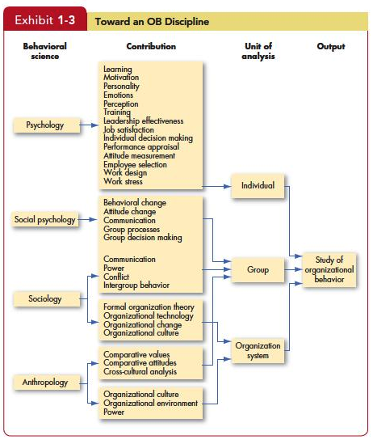
Major Behavioral Science Disciplines That Contribute to OB
Insert Exhibit 1.3
Notes:
Exhibit 1.3 from the text shows the contributions made by other disciplines to the development of organizational behavior. The predominant areas are psychology, sociology, social psychology, anthropology, and political science. Each of the disciplines has contributed specific concepts and theories to the study of OB and its increasing applications.

Slide 11
Major Behavioral Science Disciplines That Contribute to OB
Psychology
Psychology is the science that seeks to measure, explain, and sometimes change the behavior of humans and other animals.
Social Psychology
Social psychology blends the concepts of psychology and sociology.
Notes:
Psychology focuses on the individual level by seeking to measure, explain, and sometimes change behaviors in individuals. This area of study offers insights in such areas as learning, training, decision making, and employee selection.
Social Psychology moves beyond individual analysis to look at group behavior and how individuals can influence on another. It blends together sociology and psychology and looks primarily at change, communication, and group interactions.

Slide 12
Major Behavioral Science Disciplines That Contribute to OB
Sociology
Sociologists study the social system in which individuals fill their roles; that is, sociology studies people in relation to their fellow human beings.
Anthropology
Anthropology is the study of societies to learn about human beings and their activities.
Notes:
Sociology looks at the relationship between individuals and their environment. Sociologists’ main contribution to OB is through offering a better understanding of group behavior. It looks more at how a group operates within an organizational system. One key area that sociologists contribute to in OB is culture, a key factor in OB studies.
An Anthropologist studies societies to learn about the human beings and their activities. They help us understand the differences between different groups in terms of their values, attitudes, and behaviors.

Slide 13
Three Levels of Analysis in OB Model
Exhibit 1-4
Notes:
This book proposes three types of variables, inputs, processes, and outcomes, at three levels of analysis, individual, group, and organizational.
The model proceeds from left to right, with inputs leading to processes, and processes leading to outcomes.
Notice that the model also shows that outcomes can influence inputs in the future.

Slide 14
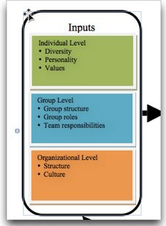
Three Levels of Analysis
Inputs
personality, group structure, and organizational culture that lead to processes.
Group structure, roles, and team responsibilities are typically assigned immediately before or after a group is formed.
1-14
Notes:
Inputs are factors that exist in advance of the employment relationships. For example, individual diversity characteristics, personality, and values are shaped by a combination of an individual’s genetic inheritance and childhood environment. Group structure, roles, and team responsibilities are typically assigned immediately before or after a group is formed.
Finally, organizational structure and culture are usually the result of years of development and change as the organization adapts to its environment and builds up customs and norms.

Slide 15
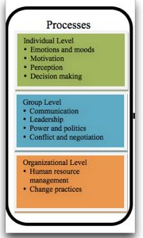
Three Levels of Analysis
Processes
actions that individuals, groups, and organizations engage in as a result of inputs and that lead to certain outcomes.
1-15
Notes:
Processes are actions that individuals, groups, and organizations engage in as a result of inputs and that lead to certain outcomes.
At the individual level, processes include emotions and moods, motivation, perception, and decision-making.
At the group level, they include communication, leadership, power and politics, and conflict and negotiation.
Finally, at the organizational level, processes include human resource management and change practices.

Slide 16
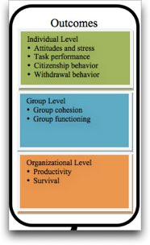
Three Levels of Analysis
Outcomes
the key variables that you want to explain or predict, and that are affected by some other variables.
1-16
Notes:
Scholars have emphasized individual-level outcomes like attitudes and satisfaction, task performance, citizenship behavior, and withdrawal behavior.
At the group level, cohesion and functioning are the dependent variables.
Finally, at the organizational level we look at overall profitability and survival. Because these outcomes will be covered in all the chapters, we’ll briefly discuss each here so you can understand what the “goal” of OB will be.

Slide 17
Dependent Variables
Attitudes and stress
The evaluations employees make, ranging from positive to negative, about objects, people, or events.
Stress
An unpleasant psychological process that occurs in response to environmental pressures.
Task performance
The combination of effectiveness and efficiency at doing your core job tasks is a reflection of your level of task performance.
Notes:
The belief that satisfied employees are more productive than dissatisfied employees has been a basic tenet among managers for years, though only now has research begun to support. Some people might think that influencing employee attitudes and stress is purely soft stuff, and not the business of serious managers, but as we will show, attitudes often have behavioral consequences that directly relate to organizational effectiveness.
Task performance is the most important human output contributing to organizational effectiveness, so in every chapter we devote considerable time to detailing how task performance is affected by the topic in question.

Slide 18
OB Variables
Citizenship behavior
The discretionary behavior that is not part of an employee’s formal job requirements, and that contributes to the psychological and social environment of the workplace.
Withdrawal behavior
The set of actions that employees take to separate themselves from the organization.
Group cohesion
The extent to which members of a group support and validate one another at work.
Notes:
In today’s dynamic workplace, where tasks are increasingly performed by teams and flexibility is critical, employees who engage in “good citizenship” behaviors help others on their team, volunteer for extra work, avoid unnecessary conflicts, respect the spirit as well as the letter of rules and regulations, and gracefully tolerate occasional work-related impositions and nuisances.
Employee withdrawal can have a very negative effect on an organization. The cost of employee turnover alone has been estimated to run into the thousands of dollars, even for entry-level positions. Absenteeism also costs organizations significant amounts of money and time every year. For instance, a recent survey found the average direct cost to U.S. employers of unscheduled absences is 8.7 percent of payroll.

Slide 19
OB Variables of Interest
Group cohesion
The extent to which members of a group support and validate one another at work.
Group functioning
The quantity and quality of a group’s work output.
Productivity
An organization is productive if it achieves its goals by transforming inputs into outputs at the lowest cost. This requires both effectiveness and efficiency.
Survival
Evidence that the organization is able to exist and grow over the long term.
Notes:
When employees trust one another, seek common goals, and work together to achieve these common ends, the group is cohesive; when employees are divided among themselves in terms of what they want to achieve and have little loyalty to one another, the group is not cohesive. And the greater the group’s cohesion, the greater is the effect of Group functioning that leads to effective outcomes with satisfying impact on group members.

Slide 20
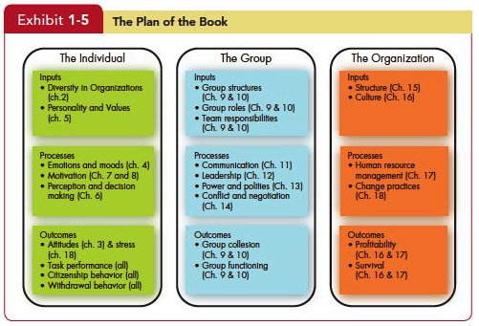
Variables of Interest
Insert Exhibit 1.5
Notes:
As you can seen in Exhibit 1-5, we will deal with inputs, processes, and outcomes at all three levels of analysis, but we group the chapters as shown here to correspond with the typical ways that research has been done in these areas.

Slide 21
Managerial Summary
Organizational behavior uses systematic study to improve predictions of behavior over intuition alone.
Because people are different, we need to look at OB in a contingency framework, using situational variables to explain cause-and-effect relationships.
Organizational behavior offers specific insights to improve a manager’s people skills.
Notes:
This first chapter has tried to provide a firm foundation that will be the basis for the study, acquisition, and application of concepts and practices to make the young professional more successful in productivity, job satisfaction, and career development. The importance of a systematic study of OB has shown that it can improve predictability of behavior, It’s not prefect, but it provides excellent roadmaps to guide managers and leaders. These studies help to ensure that contingencies are placed to better understand people’s behaviors and how to influence them for the success of the person and the organization.

Slide 22
Managerial Summary
OB helps managers to see the value of workforce diversity and practices that may need to be changed in different countries.
It can improve quality and employee productivity by showing managers how to empower their people, and help employees balance work–life conflicts.
It can help managers cope in a world of temporariness and learn how to stimulate innovation.
Finally, OB can guide managers in creating an ethically healthy work climate.
Notes:
OB helps managers see the value of the workforce and its individual characteristics. It can improve the quality and productivity of employees to increase satisfaction for employees in balancing work-life conflicts. With the temporary nature of the operation al environment, OB concepts can aid managers and leaders to cope with the ambiguity and uncertainty of the rapid changes.

