Slide 1
Chapter 6
Robbins and Judge
Perception and
Individual Decision-Making
Notes:
Chapter 6 introduces us to the concepts of perception and individual decision-making. These are topics that pervade the workplace providing opportunity for managers and leaders to be more effective and efficient in accomplishing work. So, this is an important set of concepts to focus on.

Slide 2
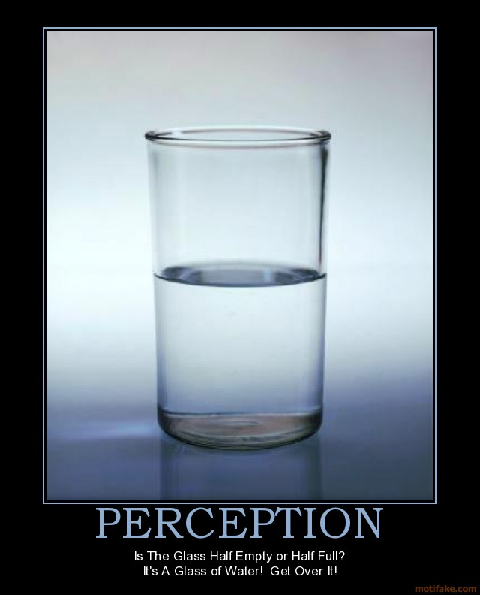
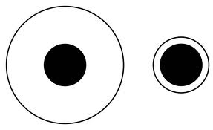

Slide 3
Perception
Perception is a process by which individuals organize and interpret their sensory impressions in order to give meaning to their environment.
It is important to the study of OB because peoples’ behaviors are based on their perception of what reality is, not on reality itself.
Notes:
Perception is a process by which individuals organize and interpret their sensory impressions in order to give meaning to their environment. It is important to the study of OB because peoples’ behaviors are based on their perception of what reality is, not on reality itself.

Slide 4
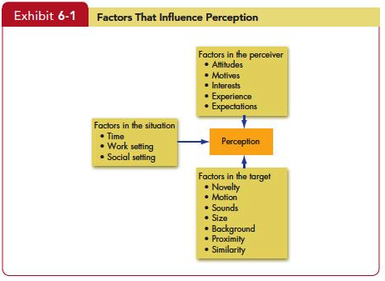
the factors that influence perception
Notes:
Factors that shape and can distort perception include the perceiver, the target, or the situation. When an individual looks at a target and attempts to interpret what he or she sees, that interpretation is heavily influenced by personal characteristics of the individual perceiver. The more relevant personal characteristics affecting perception of the perceiver are attitudes, motives, interests, past experiences, and expectations.

Slide 5
attribution theory
Attribution theory suggests that when we observe an individual’s behavior, we attempt to determine whether it was internally or externally caused.
Determination depends on three factors:
Distinctiveness
Consensus
Consistency
Notes:
Attribution theory suggests that when we observe an individual’s behavior, we attempt to determine whether it was internally or externally caused. That determination depends largely on three factors: These are Distinctiveness, Consensus, Consistency. We’ll talk more about each these in a minute.

Slide 6
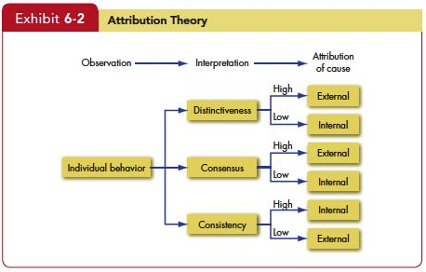
attribution theory
Internally caused - those that are believed to be under the personal control of the individual.
Externally caused - resulting from outside causes.
Notes:
First, let’s clarify the differences between internal and external causation. Internally caused behaviors are those that are believed to be under the personal control of the individual. Externally caused behavior is seen as resulting from outside causes; that is, the person is seen as having been forced into the behavior by the situation.

Slide 7
Attribution Errors
Fundamental Attribution Error
We have a tendency to underestimate the influence of external factors and overestimate the influence of internal or personal factors.
Self-serving Bias
Individuals attribute their own successes to internal factors.
Selective Perception
Any characteristic that makes a person, object, or event stand out will increase the probability that it will be perceived.
Since we can’t observe everything going on about us, we engage in selective perception.
Notes:
There are a couple of confounding concepts that impinge on Attribute Theory. First, a Fundamental Attribution Error is that we have a tendency to underestimate the influence of external factors and overestimate the influence of internal or personal factors. In addition, Self-serving Bias is a tendency for individuals to attribute their own successes to internal factors such as ability or effort while putting the blame for failure on external factors such as luck.

Slide 8
Attribution errors or shortcuts
Halo Effect
The halo effect occurs when we draw a general impression on the basis of a single characteristic.
The reality of the halo effect was confirmed in a classic study.
Contrast Effects
We do not evaluate a person in isolation.
Our reaction to one person is influenced by other persons we have recently encountered.
For example, an interview situation in which one sees a pool of job applicants can distort perception.
Distortions in any given candidate’s evaluation can occur as a result of his or her place in the interview schedule.
Notes:
The second shortcut is called the Halo Effect. The halo effect occurs when we draw a general impression on the basis of a single characteristic. This phenomenon frequently occurs when students appraise their classroom instructor. Propensity for halo effect to operate is not random.
The reality of the halo effect was confirmed in a classic study. Subjects were given a list of traits such as intelligent, skillful, practical, industrious, determined, and warm, and were asked to evaluate the person to whom those traits applied. When the word “warm” was substituted with “cold” the subjects changed their evaluation of the person. The experiment showed that subjects were allowing a single trait to influence their overall impression of the person being judged. Research suggests that it is likely to be most extreme when the traits to be perceived are ambiguous in behavioral terms, when the traits have moral overtones, and when the perceiver is judging traits with which he or she has had limited experience.

Slide 9
Attribution errors or shortcuts
Stereotyping
Judging someone on the basis of our perception of the group to which he or she belongs.
This is a means of simplifying a complex world, and it permits us to maintain consistency.
From a perceptual standpoint, if people expect to see these stereotypes, that is what they will perceive.
Notes:
The fourth shortcut is Stereotyping. Stereotyping is judging someone on the basis of our perception of the group to which he or she belongs. Generalization is not without advantages. It is a means of simplifying a complex world, and it permits us to maintain consistency. The problem, of course, is when we inaccurately stereotype. In organizations, we frequently hear comments that represent stereotypes based on gender, age, race, ethnicity, and even weight. From a perceptual standpoint, if people expect to see these stereotypes, that is what they will perceive, whether or not they are accurate.

Slide 10
Applications of Shortcuts in Organizations
Employment Interview
Evidence indicates that interviewers make perceptual judgments that are often inaccurate.
Agreement among interviewers is often poor.
Performance Expectations
Evidence demonstrates that people will attempt to validate their perceptions of reality, even when those perceptions are faulty.
Self-fulfilling prophecy or Pygmalion effect characterizes the fact that people’s expectations determine their behavior. Expectations become reality.
Notes:
Let’s look at some Specific Applications of Shortcuts in Organizations.
The first application in the Employment Interview. Evidence indicates that interviewers make perceptual judgments that are often inaccurate. In addition, agreement among interviewers is often poor. Different interviewers see different things in the same candidate and thus arrive at different conclusions about the applicant. Interviewers generally draw early impressions that become very quickly entrenched. Studies indicate that most interviewers’ decisions change very little after the first four or five minutes of the interview. Because interviews usually have so little consistent structure and interviewers vary in terms of what they are looking for in a candidate, judgments of the same candidate can vary widely.

Slide 11
Applications of Shortcuts in Organizations
Performance Evaluation
An employee’s performance appraisal is very much dependent on the perceptual process.
Many jobs are evaluated in subjective terms. Subjective measures are, by definition, judgmental.
What the evaluator perceives to be good or bad employee characteristics or behaviors will significantly influence the outcome of the appraisal.
Notes:
The third application of shortcuts is in Performance Evaluation. An employee’s performance appraisal is very much dependent on the perceptual process. Although the appraisal can be objective, many jobs are evaluated in subjective terms. Subjective measures are, by definition, judgmental. To the degree that managers use subjective measures in appraising employees, what the evaluator perceives to be good or bad employee characteristics or behaviors will significantly influence the outcome of the appraisal.

Slide 12
the link between perception and decision-making
Decision-making occurs as a reaction to a problem.
Every decision requires interpretation and evaluation of information.
Alternatives will be developed, and the strengths and weaknesses of each will need to be evaluated.
Notes:
A number of organizations in recent years have been empowering their non-managerial employees with job-related decision-making authority that historically was reserved for managers. Usually, Decision-making occurs as a reaction to a problem. There is a discrepancy between some current state of affairs and some desired state, requiring consideration of alternative courses of action. One person’s problem is another’s satisfactory state of affairs. Every decision requires interpretation and evaluation of information. The perceptions of the decision maker will address these two issues: Data are typically received from multiple sources. Which data are relevant to the decision and which are not? Alternatives will be developed, and the strengths and weaknesses of each will need to be evaluated.

Slide 13
Models of decision-making: Rational
Assumptions of the Rational Model
The decision maker has complete information;
is able to identify all the relevant options in an unbiased manner; and Chooses the option with the highest utility.
Most decisions in the real world don’t follow the rational model.
Notes:
The Six steps of the Rational Decision-Making process are listed in Exhibit 6–3. They begin with Step 1 which is Defining the problem. A problem is a discrepancy between an existing and a desired state of affairs. Many poor decisions can be traced to the decision maker overlooking a problem or defining the wrong problem. The second step is to Identify the decision criteria important to solving the problem. The decision maker determines what is relevant in making the decision. Any factors not identified in this step are considered irrelevant. This brings in the decision maker’s interests, values, and similar personal preferences. The third step is to Weight the previously identified criteria in order to give them the correct priority in the decision. In Step 4, we generate possible options that could succeed in resolving the problem. Step five has us rate each option on each criterion. Critically analyze and evaluate each option. The strengths and weaknesses of each option become evident as they are compared with the criteria and weights established in the second and third steps. And lastly is to compute the optimal decision. Evaluate each option against the weighted criteria and select the alternative with the highest total score.

Slide 14
models of decision-making: Bounded rationality
Bounded Rationality
Most people respond to a complex problem by reducing the problem to a level at which it can be readily understood.
Individuals operate within the confines of bounded rationality. They construct simplified models that extract the essential features.
How does bounded rationality work?
Once a problem is identified, the search for criteria and options begins.
Identify a limited list made up of the more conspicuous choices, which are easy to find, tend to be highly visible, and they will represent familiar criteria and previously tried-and-true solutions.
Once this limited set of options is identified, the decision maker will begin reviewing it.
Notes:
Perhaps a better definition of how a majority of decision are made is Bounded Rationality. When faced with a complex problem, most people respond by reducing the problem to a level at which it can be readily understood. This is because the limited information-processing capability of human beings makes it impossible to assimilate and understand all the information necessary to optimize. People satisfice, that is they seek solutions that are satisfactory and sufficient. Individuals operate within the confines of bounded rationality. They construct simplified models that extract the essential features.

Slide 15
models of decision-making: Intuition
Intuition
Intuition occurs outside conscious thought; it relies on holistic associations, or links between disparate pieces of information; it’s fast; and it’s affectively charged, meaning it usually engages the emotions.
The key is neither to abandon nor rely solely on intuition but to supplement it with evidence and good judgment.
Notes:
Another important decision-making technique is Intuition Perhaps the least rational way of making decisions is intuitive decision making, an unconscious process created from distilled experience. It occurs outside conscious thought; it relies on holistic associations, or links between disparate pieces of information; it’s fast; and it’s affectively charged, meaning it usually engages the emotions. While intuition isn’t rational, it isn’t necessarily wrong. Nor does it always contradict rational analysis; rather, the two can complement each other. For most of the twentieth century, experts believed decision makers’ use of intuition was irrational or ineffective. We now recognize that rational analysis has been overemphasized and, in certain instances, relying on intuition can improve decision-making. Because it is so unquantifiable, it’s hard to know when our hunches are right or wrong. The key is neither to abandon nor rely solely on intuition but to supplement it with evidence and good judgment.

Slide 16
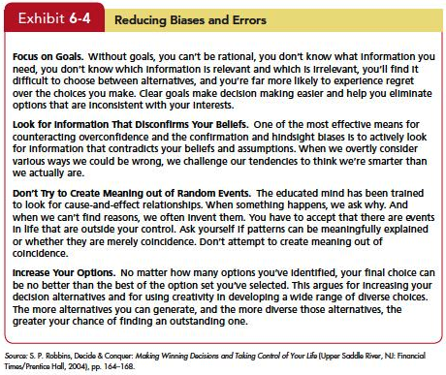
Common decision biases or errors
Notes:
Decision makers allow systematic biases and errors to creep into their judgments. People tend to rely on experience, impulses, gut feelings and rules of thumb. These can lead to distortions. Exhibit 6-4 suggests some techniques to avoid decision biases or errors. But, let’s take a look at what the specific types of biases and errors that can occur in the decision process.

Slide 17
Common decision biases or errors
Overconfidence Bias
Individuals whose intellectual and interpersonal abilities are weakest are most likely to overestimate their performance and ability.
Anchoring Bias
Fixating on initial information as a starting point and failing to adequately adjust for subsequent information.
Confirmation Bias
Type of selective perception.
Seek out information that reaffirms past choices, and discount information that contradicts past judgments.
Availability Bias
Tendency for people to base judgments on information that is readily available.
Notes:
The first is Overconfidence Bias. Individuals whose intellectual and interpersonal abilities are weakest are most likely to overestimate their performance and ability. The tendency to be too confident about their ideas might keep some from planning how to avoid problems that arise. Investor overconfidence operates in a variety of ways. People think they know more than they do, and it costs them. Investors, especially novices, overestimate not just their own skill in processing information, but also the quality of the information they’re working with.
Second is Anchoring Bias. This is fixating on initial information as a starting point and failing to adequately adjust for subsequent information. Anchors are widely used by people in advertising, management, politics, real estate, and lawyers—where persuasion skills are important. Any time a negotiation takes place, so does anchoring.

Slide 18
Common decision biases or errors
Escalation of Commitment
Staying with a decision even when there is clear evidence that it’s wrong.
Randomness Error
Decision-making becomes impaired when we try to create meaning out of random events.
Risk Aversion
Risk-averse employees will stick with the established way of doing their jobs, rather than taking a chance on innovative or creative methods.
Hindsight Bias
Tendency to believe falsely that one has accurately predicted the outcome of an event, after that outcome is actually known.
Notes:
Fifth is Escalation of Commitment. This is staying with a decision even when there is clear evidence that it’s wrong. People who carefully gather and consider information consistent with the rational decision-making model are more likely to engage in escalation of commitment than those who spend less time thinking about their choices.
Sixth is Randomness Error. Decision-making becomes impaired when we try to create meaning out of random events.

Slide 19
ethical decision-criteria
Utilitarian criterion—decisions are made solely on the basis of their outcomes or consequences.
Focus on rights—calls on individuals to make decisions consistent with fundamental liberties and privileges as set forth in documents such as the Bill of Rights.
Impose and enforce rules fairly and impartially to ensure justice or an equitable distribution of benefits and costs.
Notes:
Ethical considerations should be an important criterion in organizational decision-making. Three Ethical Decision Criteria include the Utilitarian criterion, which is when decisions are made solely on the basis of their outcomes or consequences. The Focus on rights calls on individuals to make decisions consistent with fundamental liberties and privileges as set forth in documents such as the Bill of Rights. A third criterion is to impose and enforce rules fairly and impartially to ensure justice or an equitable distribution of benefits and costs. Union members typically favor this view.
Each criterion has advantages and liabilities. A focus on utilitarianism promotes efficiency and productivity, but it can sideline the rights of some individuals, particularly those with minority representation. The use of rights protects individuals from injury and is consistent with freedom and privacy, but it can create a legalistic environment that hinders productivity and efficiency. Public concern about individual rights and social justice suggests managers should develop ethical standards based on nonutilitarian criteria. A focus on justice protects the interests of the underrepresented and less powerful, but it can encourage a sense of entitlement that reduces risk taking, innovation, and productivity.
There are no global ethical standards, as contrasts between Asia and the West illustrate. Although ethical standards may seem ambiguous in the West, criteria defining right and wrong are actually much clearer there than in Asia, where few issues are black and white and most are gray. Global organizations must establish ethical principles for decision makers in countries such as India and China and modify them to reflect cultural norms if they want to uphold high standards and consistent practices.

Slide 20
Creativity: the three-component model of creativity
Expertise
Creativity
Creative Thinking Skills
Intrinsic Task Motivation
Notes:
Creativity is the ability to produce novel and useful ideas. These are ideas that are different from what has been done before, but that are also appropriate to the problem or opportunity presented. Creative Potential. Most people have creative potential. People differ in their inherent creativity. A study of lifetime creativity of 461 men and women found that less than one percent were exceptionally creative.
The Three-Component Model of Creativity proposes that individual creativity essentially requires expertise, creative-thinking skills, and intrinsic task motivation. Expertise is the foundation for all creative work. The potential for creativity is enhanced when individuals have abilities, knowledge, proficiencies, and similar expertise in their field of endeavor. Creative thinking skills encompasses personality characteristics associated with creativity, the ability to use analogies, as well as the talent to see the familiar in a different light. Intrinsic task motivation includes the desire to work on something because it’s interesting, involving, exciting, satisfying, or personally challenging. This turns creativity potential into actual creative ideas. It determines the extent to which individuals fully engage their expertise and creative skills.

Slide 21
Summary and Implications for Managers
Perception
How do employees perceive the manager?
How do employees perceive their jobs?
How do employees perceive opportunity at the company?
Do employees distort reality?
Individual Decision-making
Analyze the situation
Be aware of biases
Combine rational and intuition
Enhance creativity
Notes:
The concepts presented in this chapter began with a discussion of Perception. Individuals base their behavior not on the way their external environment actually is but rather on what they see or believe it to be. Whether a manager successfully plans and organizes the work of employees and actually helps them to structure their work more efficiently and effectively is far less important than how employees perceive the manager’s efforts. Employees judge issues such as fair pay, performance appraisals, and working conditions in very individual ways. To influence productivity, we need to assess how workers perceive their jobs. Absenteeism, turnover, and job satisfaction are also reactions to an individual’s perceptions. Dissatisfaction with working conditions and the belief that an organization lacks promotion opportunities are judgments based on attempts to create meaning in the job. The employee’s conclusion that a job is good or bad is an interpretation. Managers must spend time understanding how each individual interprets reality and, when there is a significant difference between what someone sees and what exists, try to eliminate the distortions.

