Slide 1
Chapter 7
Robbins and Judge
Motivational Concepts
Notes:
Chapter 7 introduces us to the concepts of motivation. These are topics that pervade the workplace providing opportunity for managers and leaders to be more effective and efficient in accomplishing work. So, this is an important set of concepts to focus on.

Slide 2
key elements of motivation
Motivation is “the processes that account for an individual’s intensity, direction, and persistence of effort toward attaining a goal.”
Many people incorrectly view motivation as a personal trait.
Key Elements
Intensity is concerned with how hard a person tries.
Direction is the orientation that benefits the organization.
Persistence is a measure of how long a person can maintain his/her effort.
Notes:
Many people incorrectly view motivation as a personal trait—that is, some have it and others do not. Motivation is the result of the interaction of the individual and the situation. Our Definition of Motivation is that it is “the processes that account for an individual’s intensity, direction, and persistence of effort toward attaining a goal.” We will narrow the focus to organizational goals in order to reflect our singular interest in work-related behavior.

Slide 3
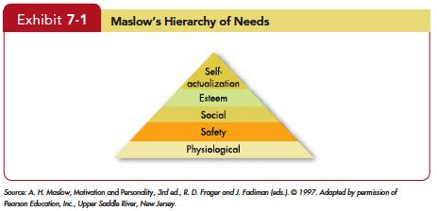
early theories of motivation
- Maslow’s need theory has received wide recognition, particularly among practicing managers.
- Research does not generally validate the theory.
- Some researchers have attempted to revive components of the need hierarchy concept, using principles from evolutionary psychology.
Notes:
Abraham Maslow’s hierarchy of needs is the most well known theory of motivation. He hypothesized that within every human being there exists a hierarchy of five needs. These begin with Physiological needs that include hunger, thirst, shelter, sex, and other bodily needs. The second level is Safety needs that include security and protection from physical and emotional harm. The next level is Social needs and it includes affection, belongingness, acceptance, and friendship. Reaching a higher level we find Esteem needs that includes internal esteem factors such as self-respect, autonomy, and achievement; and external esteem factors such as status, recognition, and attention. At the top of the hierarchy is Self-actualization needs. This is the drive to become what one is capable of becoming; includes growth, achieving one’s potential, and self-fulfillment.
As a need becomes substantially satisfied, the next need becomes dominant. No need is ever fully gratified; a substantially satisfied need no longer motivates.
.

Slide 4
early theories of motivation: Theory x & theory y
Theory X assumptions are basically negative.
Employees inherently dislike work and, whenever possible, will attempt to avoid it.
They must be coerced, controlled, or threatened with punishment.
Theory Y assumptions are basically positive.
Employees can view work as being as natural as rest or play.
Notes:
Douglas McGregor’s Theory X and Theory Y concluded that a manager’s view of the nature of human beings is based on a certain grouping of assumptions and he or she tends to mold his or her behavior toward employees according to these assumptions.
Theory X assumptions are basically negative. Employees inherently dislike work and, whenever possible, will attempt to avoid it. Since employees dislike work, they must be coerced, controlled, or threatened with punishment. Employees will avoid responsibilities and seek formal direction whenever possible. Most workers place security above all other factors and will display little ambition.
Theory Y assumptions are basically positive. Employees can view work as being as natural as rest or play. People will exercise self-direction and self-control if they are committed to the objectives.

Slide 5
Theory x & theory y
The implications for managers are best explained by using Maslow’s framework:
Theory X: lower-order needs dominate individuals.
Theory Y: higher-order needs dominate individuals.
McGregor himself believed that Theory Y assumptions were more valid than Theory X.
No evidence to confirm that either of is valid.
Notes:
What are the implications for managers? This is best explained by using Maslow’s framework Theory X assumes that lower-order needs dominate individuals. Theory Y assumes that higher-order needs dominate individuals. McGregor himself held to the belief that Theory Y assumptions were more valid than Theory X. There is no evidence to confirm that either set of assumptions is valid.

Slide 6
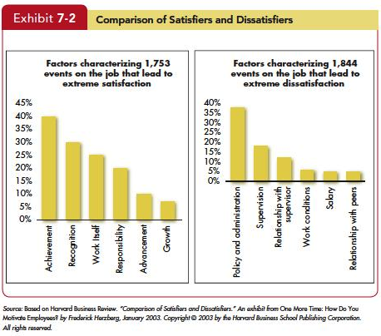
early theories of motivation
Notes:
The Two-Factor Theory is sometimes also called motivation-hygiene theory. Proposed by psychologist Frederick Herzberg when he investigated the question, “What do people want from their jobs?” He asked people to describe, in detail, situations in which they felt exceptionally good or bad about their jobs. These responses were then tabulated and categorized. From the categorized responses, Herzberg concluded that Intrinsic factors, such as advancement, recognition, responsibility, and achievement seem to be related to job satisfaction. Dissatisfied respondents tended to cite extrinsic factors, such as supervision, pay, company policies, and working conditions. The opposite of satisfaction is not dissatisfaction. Removing dissatisfying characteristics from a job does not necessarily make the job satisfying. Job satisfaction factors are separate and distinct from job dissatisfaction factors.

Slide 7
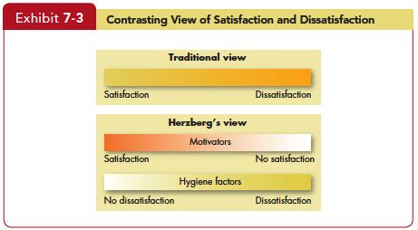
early theories of motivation: tw0-factor theory
Notes:
Managers who eliminate job dissatisfaction factors may not necessarily bring about motivation. Please look at Exhibit 7-3. It reveals that when hygiene factors are adequate, people will not be dissatisfied. Neither will they be satisfied. To motivate people, managers must emphasize factors intrinsically rewarding that are associated with the work itself or to outcomes directly derived from it.

Slide 8
early theories of motivation: Tw0-factor theory
Criticisms of Herzberg’s theory:
Limited because it relies on self-reports.
The reliability of methodology is questioned.
No overall measure of satisfaction was utilized.
Herzberg assumed a relationship between satisfaction and productivity, but the research methodology he used looked only at satisfaction, not at productivity.
Notes:
Recent review of Herzberg’s research has resulted in many criticisms of the theory. For example, The procedure that Herzberg used is limited by its methodology. The reliability of Herzberg’s methodology is questioned. No overall measure of satisfaction was utilized. Herzberg assumed a relationship between satisfaction and productivity, but the research methodology he used looked only at satisfaction, not at productivity.
Regardless of criticisms, Herzberg’s theory has been widely read, and few managers are unfamiliar with his recommendations. The popularity of vertically expanding jobs to allow workers greater responsibility can probably be attributed to Herzberg’s findings.

Slide 9
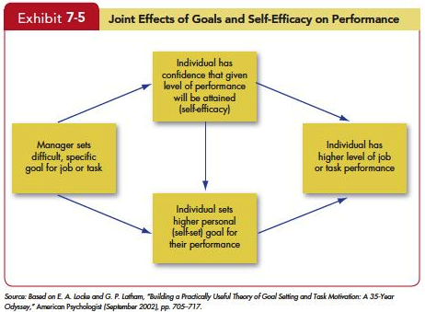
Contemporary motivation theories: Self-Efficacy Theory
Known also as social cognitive theory and social learning theory
Self-Efficacy Theory
Enactive mastery
Vicarious modeling
Verbal persuasion
Arousal
Notes:
Self-Efficacy Theory is a new theory gaining much attention. Albert Bandura, developer of self-efficacy theory defined four characteristics. First is Enactive mastery that is gaining relevant experience with the task or job. Second is Vicarious modeling, or becoming more confident because you see someone else doing the task. Third is Verbal persuasion when a person is more confident because someone convinces you that you have the skills. And lastly is Arousal that leads to an energized state driving a person to complete the task. This theory is also known also as social cognitive theory and social learning theory

Slide 10
Self-Efficacy Theory
Implications of Efficacy Theory
Training programs often make use of enactive mastery by having people practice and build their skills.
The best way for a manager to use verbal persuasion is through the Pygmalion effect or the Galatea effect.
Intelligence and personality are absent from Bandura’s list, but they can increase self-efficacy.
Notes:
The implications of Efficacy Theory are many. First, training programs often make use of enactive mastery by having people practice and build their skills. In fact, one reason training works is that it increases self-efficacy. Individuals with higher levels of self-efficacy also appear to reap more benefits from training programs and are more likely to use their training on the job. The best way for a manager to use verbal persuasion is through the Pygmalion effect or the Galatea effect.
As discussed in Chapter 5, the Pygmalion effect is a form of self-fulfilling prophecy in which believing something can make it true. In some studies, teachers were told their students had very high IQ scores when in fact they spanned a range from high to low. Consistent with the Pygmalion effect, the teachers spent more time with the students they thought were smart, gave them more challenging assignments, and expected more of them—all of which led to higher student self-efficacy and better grades. This strategy also has been used in the workplace. Sailors who were told convincingly that they would not get seasick were in fact much less likely to do so. Intelligence and personality are absent from Bandura’s list, but they can increase self-efficacy. People who are intelligent, conscientiousness, and emotionally stable are so much more likely to have high self-efficacy that some researchers argue self-efficacy is less important than prior research would suggest. They believe it is partially a by-product in a smart person with a confident personality. Although Bandura strongly disagrees with this conclusion, more research is needed.

Slide 11
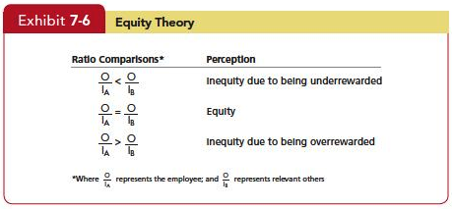
equity theory
Which referent an employee chooses will be influenced by the information the employee holds about referents, as well as by the attractiveness of the referent.
Gender, Length of tenure, Level in the organization,
Professional ranks and higher education
Notes:
What role does equity play in motivation? An employee with several years experience can be frustrated to find out that a recent college grad hired at a salary level higher than he or she is currently earning, causing motivation levels to drop. Why? Employees make comparisons of their job inputs and outcomes relative to those of others. See Exhibit 7-6. If we perceive our ratio to be equal to that of the relevant others with whom we compare ourselves, a state of equity is said to exist. We perceive our situation as fair. When we see the ratio as unequal, we experience equity tension. Additionally, the referent that an employee selects adds to the complexity of equity theory. There are four referent comparisons that an employee can use. First is Self-inside, which is based on an employee’s experiences in a different position inside his or her current organization. Second is Self-outside, which is based on an employee’s experiences in a situation or position outside his or her current organization. Third is Other-inside where another individual or group of individuals inside the employee’s organization Is the basis of comparison. Other-outside: Another individual or group of individuals outside the employee’s organization work and the amount of effort you allocate to each task are affected by the consequences that follow. If you’re consistently reprimanded for out producing your colleagues, you’ll likely reduce your productivity. But we might also explain your lower productivity in terms of goals, inequity, or expectancies.

Slide 12
equity theory
When employees perceive an inequity, they can be predicted to make one of six choices:
Change their inputs.
Change their outcomes.
Distort perceptions of self.
Distort perceptions of others.
Choose a different referent.
Leave the field.
Notes:
When employees perceive an inequity, they can be predicted to make one of six choices. They can change their inputs. They can change their outcomes. They can distort perceptions of self. They can distort perceptions of others. They can choose a different referent. Or, they can leave the field.

Slide 13
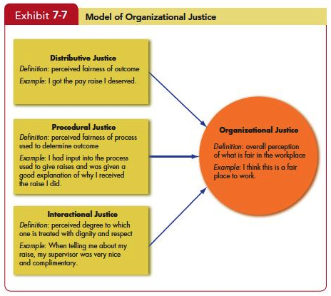
equity theory
Notes:
But organizational justice draws a bigger picture. Exhibit 7-7 shows a model of organizational justice. Employees perceive their organizations as just when they believe rewards and the way they are distributed are fair. In general, people see allocations or procedure favoring themselves as fair. Few people really make mathematical calculations of their inputs relative to the outcomes of others. They base distributive judgments on a feeling or an emotional reaction to how they think they are treated relative to others, and their reactions are often emotional as well. Our discussion has also focused on reactions to personal mistreatment. People react emotionally to injustices committed against others, prompting them to take retributive actions. The other key element of organizational justice is the view that justice is multidimensional. How much we get paid relative to what we think we should be paid (distributive justice) is obviously important. But, according to researchers, how we get paid is just as important. Thus the model of organizational justice includes procedural justice—the perceived fairness used to determine the distribution of rewards. Two key elements of procedural justice are process control and explanations. Process control is the opportunity to present your point of view about desired outcomes to decision makers. Explanations are clear reasons management gives for the outcome. Thus, for employees to see a process as fair, they need to feel they have some control over the outcome and that they were given an adequate explanation about why the outcome occurred. It’s also important that a manager is consistent (across people and over time), is unbiased, makes decisions based on information, and is open to appeals. The effects of procedural justice become more important when distributive justice is lacking. If we don’t get what we want, we tend to focus on why. If your supervisor gives a cushy office to a co-worker instead of to you, you’re much more focused on your supervisor’s treatment of you than if you had gotten the office. Explanations are beneficial when they take the form of post hoc excuses (“I know this is bad, and I wanted to give you the office, but it wasn’t my decision”) rather than justifications (“I decided to give the office to Sam, but having it isn’t a big deal.”). Interactional justice describes an individual’s perception of the degree to which she is treated with dignity, concern, and respect. When people are treated in an unjust manner (at least in their own eyes), they retaliate (for example, badmouthing a supervisor). Because people intimately connect interactional justice or injustice to the conveyer of the information, we would expect perceptions of injustice to be more closely related to the supervisor. Of these three forms of justice, Distributive justice is most strongly related to organizational commitment and satisfaction with outcomes such as pay. Procedural justice relates most strongly to job satisfaction, employee trust, withdrawal from the organization, job performance, and citizenship behaviors. There is less evidence about interactional justice.

Slide 14
Expectancy theory
Expectancy theory argues that a tendency to act in a certain way depends on an expectation that the act will be followed by a given outcome and the attractiveness of that outcome to the individual.
An employee will be motivated to exert a high level of effort when he/she believes that:
Effort will lead to a good performance appraisal.
A good appraisal will lead to rewards.
The rewards will satisfy his/her personal goals.
Notes:
Expectancy theory is one of the most widely accepted explanations of motivation. Victor Vroom’s expectancy theory has its critics but most of the research is supportive. Expectancy theory argues that the strength of a tendency to act in a certain way depends on the strength of an expectation that the act will be followed by a given outcome and on the attractiveness of that outcome to the individual. It says that an employee will be motivated to exert a high level of effort when he/she believes that effort will lead to a good performance appraisal. That a good appraisal will lead to organizational rewards, and that the rewards will satisfy his/her personal goals.

Slide 15
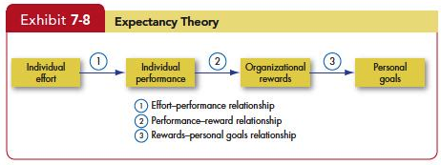
Expectancy theory
Notes:
Three key relationships in Expectancy Theory include the Effort-performance relationship, which is the the probability perceived by the individual that exerting a given amount of effort will lead to performance. Second, Performance-reward relationship is the degree to which the individual believes that performing at a particular level will lead to the attainment of a desired outcome. And third, Rewards-personal goals relationship is the degree to which organizational rewards satisfy an individual’s personal goals or needs and the attractiveness of those potential rewards for the individual.

Slide 16
expectancy theory and employees motivation
The key to expectancy theory is the understanding of an individual’s goals and the linkage between effort and performance, between performance and rewards, and finally, between the rewards and individual goal satisfaction.
Some critics suggest that the theory has only limited use, arguing that it tends to be more valid for predicting in situations where effort-performance and performance-reward linkages are clearly perceived by the individual.
Notes:
The key to expectancy theory is the understanding of an individual’s goals and the linkage between effort and performance, between performance and rewards, and finally, between the rewards and individual goal satisfaction. Some critics suggest that the theory has only limited use, arguing that it tends to be more valid for predicting in situations where effort-performance and performance-reward linkages are clearly perceived by the individual.

